Slide 1
Sorcero Task: Claim fact checking
By: Shivam Ralli
Contact me at:
Linkedin: https://linkedin.com/in/shivam-ralli
Kaggle: https://www.kaggle.com/hoshi7

Slide 2
What is fact checking?
Fact-checking is the task of verifying the veracity of claims by assessing their assertions against credible evidence.
Generally in the past, fact checking was moslty limited to political claims and barely any research happened in any other field.
For this task, like it happens at Sorcero with language intelligence, the task was to use a transformer model to create a health based fact checking model.

Slide 3
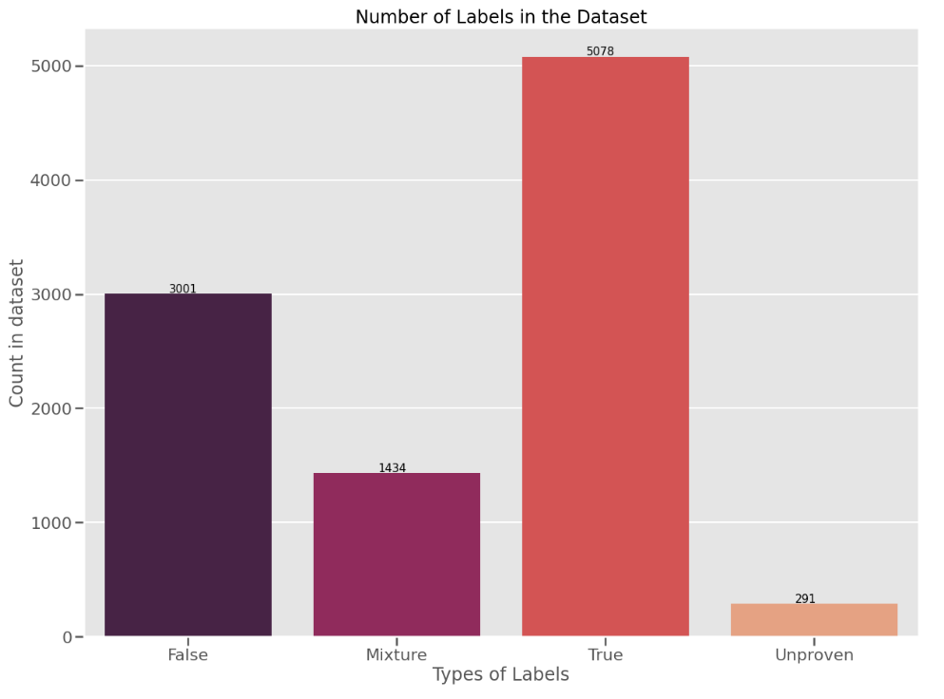
Dataset outlook:
We can see that the dataset is imbalanced. Although, the language models are generally capable of performing well on the imbalanced dataset, this allows us to understand that it is an avenue we can consider while training.

Slide 4
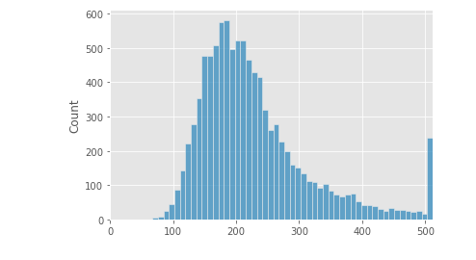
Number of Tokens
After concatenating the sentences with the claim, we can see that out of 9000 train examples:
Only around 250 are over 512 tokens.
Thus, the max token lengths were kept at 512 itself.

Slide 5
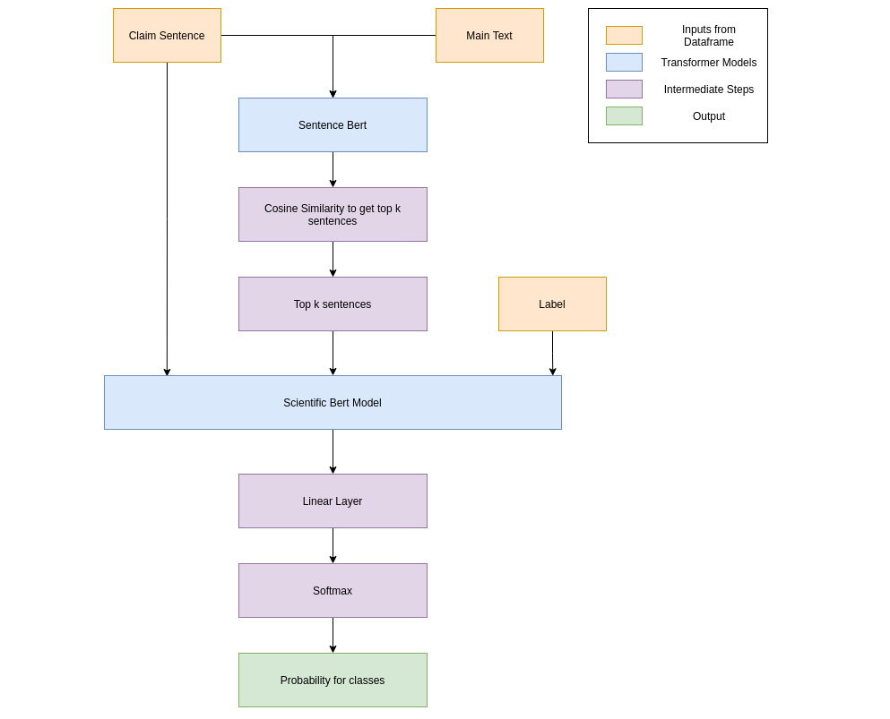
Architecture followed:

Slide 6
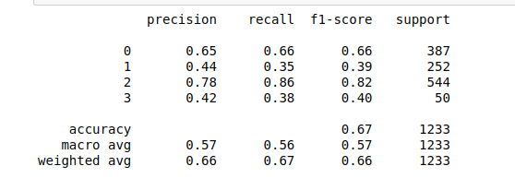
Results:
After training for 2 epochs, we can see that the macro f1 we are getting is 0.57.
This can be improved by using other complex techniques as discussed in the notebook, such as but not limited to: k-fold, hyper parameter tuning, complex DNN models.

Slide 7
Thank You

